Slide 1
Module 2 Introduction to Control Systems & SCADA

Slide 2
Lesson Objectives
2.1 Describe the components and applications of industrial control systems.
2.2 Describe the purpose and use of SCADA, DCS, and PCS systems.
2.3 Describe and demonstrate the configuration and use of field devices used to measure critical infrastructure processes, such as flow rate, pressure, temperature, level, density, etc.
2 .4 Describe and demonstrate the use and application of PLCs in automation.

Slide 3
Industrial Control Systems (ICS)
Control systems that are used in industrial production and critical infrastructures, such as electricity, water, wastewater, transportation, and oil
Information collected from remote stations is sent over communication links to remote station control devices (field devices) that collect data and act accordingly (i.e., opening valves, sending alerts)
Consist of Supervisory Control and Data Acquisition (SCADA) systems, Distributed Control Systems (DCS), Process Control Systems (PCS), and Programmable Logic Controllers (PLCs)
Notes:
Industrial control systems (ICS) consist of many other types of control systems, including supervisory control and data acquisition (SCADA) systems (defined later), distributed control systems (DCS), and PLCs (Programmable Logic Controllers) used to automate services.
SCADA systems are made up of computers, networks, and sensors used to control industrial processes. Usually, the term SCADA is used to refer to systems that span large geographic areas (i.e., gas pipelines, electric power lines), while DCS usually control systems located in a local area (i.e., a factory).
PLCs are solid-state control systems with programmable memory that are used for the discrete control of specific applications (i.e., data and file processing). (NIST SP 800-62)
SCADA and DCS are often networked together, as with electric power control centers and power generation facilities. Power generation facility operations are controlled by DCS, which must then communicate and coordinate with SCADA systems for power distribution.

Slide 4
What is SCADA?
It’s an acronym that stands for
Supervisory
Control
And
Data
Acquisition
Put simply, it means bringing plant/process data into a computer system.
Notes:
Supervisory control and data acquisition (SCADA) is any system that provides for remote monitoring and control of industrial devices and equipment. NOTE: SCADA is sometimes referred to as “HMI” (Human-Machine Interface). There is a difference —A HMI refers software or hardware with which an operator interacts to monitor or control a device. An example would be a panel. HMI is a subs et of SCADA—however both terms are generally used.
SCADA systems use remote terminal units (RTUs) to send data back to a control center.

Slide 5
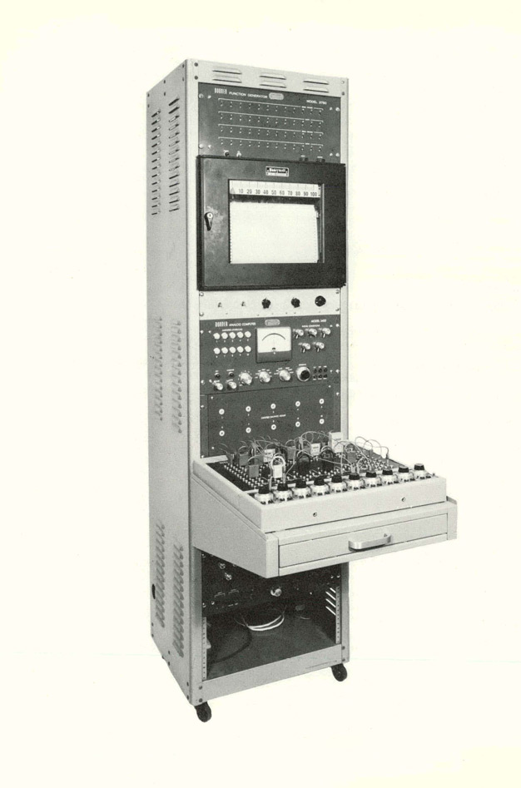
Supervisory Control
Gives an operator the ability to control processes and equipment without having to run out into the field and do everything manually.
DOE’s Office of Scientific and Technical Information (OSTI), Office of Science [Public domain], via Wikimedia Commons
Notes:
Prior to the development of SCADA in the mid-20th century, operators of manufacturing and industrial plants, had to visit the sites to manually control and monitor the equipment. As systems grew larger, more distant in location, and more complex, it became necessary to fully automate the monitoring and control process. This involved transmitting the data remotely to centralized systems. Today, SCADA systems are networked and can be monitored and controlled in real-time remotely from anywhere in the world.

Slide 6
Data Acquisition
Collecting process information from all over your plant, displaying it, and storing it for future reference.
Notes:
Not only is data acquired from field devices, sent over high-speed communication links to the controllers, commands can be pushed from the control systems to the field devices.

Slide 7
4 Types of SCADA
Monolithic SCADA System
Distributed SCADA System
Networked SCADA System
Internet of Things (IoT) SCADA System

Slide 8
Monolithic SCADA System
Earliest type (1st gen) SCADA systems
Expensive
Sharing information was difficult
Notes:
Due to the use of proprietary hardware, software, and well as networking protocols, each SCADA system was largely an island onto itself, with no connectivity to other systems. Large mainframes were used as both the primary system, as well as another for a standalone system that served as a backup. These backup mainframes were expensive to operate, as they served no purpose unless there was a failure at the primary system.

Slide 9
Distributed SCADA System
2nd Gen
SCADA systems are typically client/server systems.
Computers can be networked in any configuration that is valid under Windows (LAN, WAN).
SCADA systems typically can connect to a database and share information with it.
SCADA systems can be set up with redundancy (fault tolerance).
Notes:
Gen 2
SCADA systems leveraged smaller computer components (minicomputer) that were less expensive than previous mainframes. Different systems could be connected to perform different functions with some serving as communications processors, others as a database server to house the information, others as the HMI for operators. This provided for more efficient processing capabilities (were faster). They also used local area networks (LANs) to connect system components, however the continued use of proprietary protocols continues to make sharing across different platforms difficult. Redundancy improved, however, and was less costly than with monolithic systems, as different systems were available for failover.
SCADA systems are typically CLIENT/SERVER systems, meaning:
Once data is collected, it becomes available (viewable) by any other SCADA computer that is set up to be part of that same system.
Computers can be networked in any configuration that is valid under Windows (LAN, WAN).
You can have a server collecting data in Phoenix and have a client PC on your desk here, viewing that data in real time, using the internet as a virtual private network.
SCADA systems typically can connect to a database and share information with it.
The SCADA database may store the state of the entire system (sensors, valves, switches) – for instance, the level of gas and oil in tanks
SCADA systems can be set up with redundancy (fault tolerance).
Always a good idea, but not everybody does it because it can get expensive to deploy.

Slide 10
Networked SCADA System
3rd generation systems
Adoption of “open” hardware and software
Leveraged LAN and WAN technologies, including the use of fiber optics, for communications
Notes:
Gen 3 SCADA (“networked”) systems.
Adoption of “open” hardware and software
Gen 3 SCADA systems moved from proprietary hardware, software, and network protocols that were tied to a single vendor to more open standards, significantly reducing costs as hardware could be procured from a number of different vendors.
Leveraged LAN and WAN technologies, including the use of fiber optics, for communications
The use of open communication standards and high-speed communications provided enhanced reliability, as backup capability (failover) could be distributed across larger geographic areas, important in the event that a regional disaster disabled capabilities at one site.

Slide 11
What’s Next? IoT SCADA
Considered to be 4th Generation
Leverages cloud computing
Reduced cost
Increased data accuracy
Scalability
Better security
World-wide remote-control capabilities
Notes:
4th Generation
Still shaking out in the industry.
Leverages cloud computing
Cloud computing affords better scalability, reliability, and security capabilities. When the Internet of Things (IoT) is integrated with SCADA it allows for better data collection and extraction from devices.
World-wide remote-control capabilities
Can be accessed anywhere.

Slide 12
What’s in it for me? “DART”
Displays
See everything in ways that make sense to the people who run the place. “Mimic” graphics, trend charts, etc.
Alarms
Monitor process and alert staff
Audit logs
Reports
On demand or generated automatically at the end of the shift/day/week/month/year.
Trending; historical data logging; chart recorder
Visually analyze process over time
Instantaneous recall

Slide 13
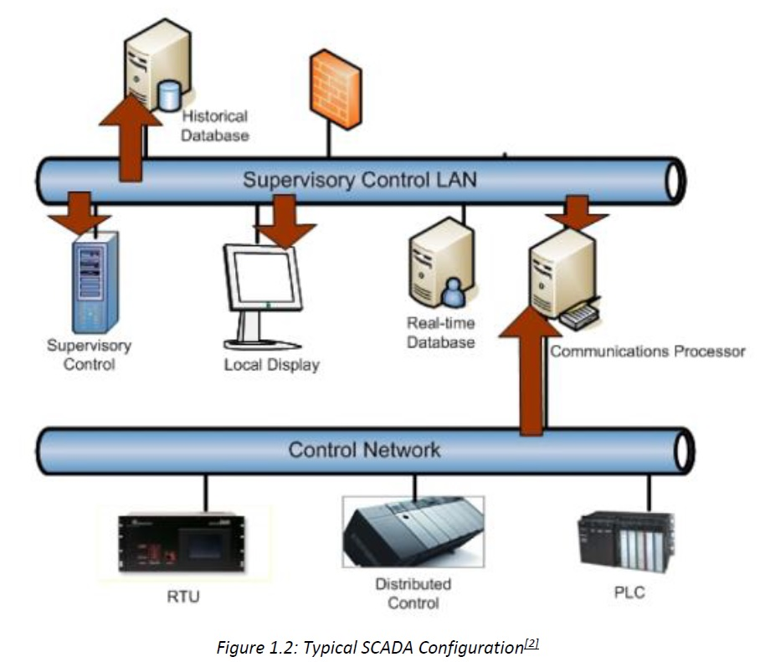
Display Screens
Notes:
Department of Homeland Security, United States. (2011). “Figure 5: Example of supervisory control LAN attack targets”. Cybersecurity Assessments of Industrial Control Systems, Good Practice Guide. (April 2011). pp. 17. Available for download at https://www.ccn-cert.cni.es/publico/InfraestructurasCriticaspublico/CPNI-Guia-SCI.pdf.

Slide 14
Field Devices – Measuring the Process
Field devices measure flow rate, pressure, temperature, level, etc.
Three main communication methods:
Analog devices (variable reading)
Discrete or digital devices (ON or OFF)
Computer protocols (serial communications)
Notes:
Three main communication methods:
Analog devices (variable reading)
Typically powered by 24 volts DC ‘current loop’
Indicate output in 4 to 20 milliamps range
Discrete or digital devices (ON or OFF)
Can be powered by AC or DC
Output can be a voltage (pulse), relay closure, etc.
Computer protocols (serial communications)
Many manufacturers have their own, but many are considered standards (Modbus, DNP, HART)
Can carry almost any kind of information

Slide 15
Moving Data Around
Hard-wired
Local, in-plant, short runs
Radio telemetry (“wireless”)
Can move protocol-based information and even electrical signals
Increasingly popular due to relatively low-cost and unlicensed radio technology (no more FCC hassles)
Can move data out of very remote/inaccessible locations
Only requirement is power and a place to mount an antenna
Ranges in miles

Slide 16
Giving It a Place to Land: PLCs and RTUs
PLC – Programmable Logic Controller
RTU – Remote Telemetry Unit
Terms are fairly general, sometimes interchangeable.
Basic functions are:
Process controller — Monitors process feedback and issue control signals
Data concentrator — Gets all of the process data into one place to make it easy to use with computers via a single communication protocol

Slide 17
To Control or Not to Control?
PLCs can run an entire complex process, but they can also be used as data concentrators only. How do they do this?
They typically have screw terminals where instrument signals are landed. The four basic types of signal are:
DI - Digital Inputs (on/off status)
DO – Digital Outputs (open/close commands)
AI – Analog Inputs (variable readings)
AO – Analog Outputs (VFD or valve position commands)
Notes:
Electrical signals are pushed across the wire to a terminal block, or a modular block securely connecting two or more wires. Wires are secured to the terminal block in a number of different ways: screw-type, push-fit and insulation displacement connector (IDC), depending largely on the wire type.
Screw-type terminal blocks use a screw to clamp a wire to the block.
Push-fit terminal blocks use spring-loaded levers that allow wires to easily enter the terminal block.
Insulation displacement connectors (IDC) allow the unstripped wire to be inserted into the terminal block and then the insulation on the wire is removed by blades inside the connection to allow it to make contact with the conductor.

Slide 18
To Control or Not to Control? (cont. 1)
Logic Program: PLCs are like small computers that can be programmed to behave in any way you need them to work.
Examples:
If the tank level (coming in at AI #2) is lower than 3 feet, then turn on the pump command (going out of DO#6) to refill the tank.
If the tank full level switch (DI #2) closes, then stop the pump (DO#6 off).
Notes:
An excellent video, Waste Water Treatment -SCADA - Plant-IQ, to show students is located at https://youtu.be/ZSFdOjxB-1I

Slide 19
To Control or Not to Control? (cont. 2)
Logic Programming Languages:
Function Block Diagram – analogous to a digital electronics schematic
Ladder Logic – analogous to an AC wiring diagram
Structured Text – analogous to “plain English” or the old “BASIC” language
Notes:
There are several different styles of programming languages. Most manufacturers favor a particular programming environment; however, some allow you to choose which one you like, or can even mix and match languages.

Slide 20
To Control or Not to Control? (cont. 3)
Data Concentrator – The logic program is not mandatory
Perhaps a process is already being controlled by some other equipment or doesn’t need any additional control. The PLC is still useful as a centralized place to organize all of the process information.
Every screw terminal has an address or designator, so that it can be individually referenced from the computer.
The naming or formatting convention of the addressing scheme is specific to each protocol or manufacturer.

Slide 21
Bringing It All Home
Now that the field instrument data has been concentrated at the PLC, just a single link is needed from the PLC back to the computer in order to have the process data available in real-time.
Two ways to make this connection:
Serial (RS-232 or RS-485) – traditional, relatively slow; single protocol per bus
Ethernet (copper or fiber optic) – fast, increasingly popular; can handle multiple protocols through a single port
Notes:
Serial:
Typical speeds are 9600 bps to 19.2 kbps. Faster is possible, but with reduced reliability and confidence.
Requires careful wiring (true daisy chain configuration, no T-splices)
RS-232: point-to-point, local connection, 50 feet max
RS-485: multi-drop daisy chain, 4000 feet max
Ethernet:
10 Mbps
Standardized cables make it a plug-and-play proposition
Copper – 324 feet max between hubs/switches/routers
Fiber – up to 10 miles; fast and resistant to interference, but fragile and relatively expensive

Slide 22
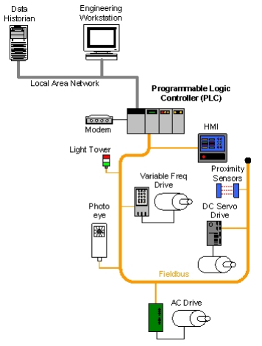
PLC Control System Implementation Example
Image source: DHS
Notes:
Example of a manufacturing process being controlled by a PLC over a Field bus network (the next lecture will discuss Field bus networks). In this case the engineering workstation contains an interface to the PLC. The Data Historian to the left of the workstation is used to store data that is transmitted over the Local Area Network.
Image attribution (Public Domain):
“Figure 2-8. PLC Control System Implementation Example.” By Falco, J., Kent, K., Stouffer, K., “Guide to Supervisory Control and Data Acquisition (SCADA) and Industrial Control Systems Security: Recommendations of the National Institute of Standards and Technology.” NIST Special Publication 800-82. INITIAL PUBLIC DRAFT. NIST. Technology and Administration. Department of Commerce. United States. September 2006. <https://www.dhs.gov/sites/default/files/publications/csd-nist-guidetosupervisoryanddataccquisition-scadaandindustrialcontrolsystemssecurity-2007.pdf>

Slide 23
SCADA Data
Now, that we have our data, what can we do with it?
Meaningful displays for the operators
Methods of control
Historical data logging and trending
Includes statistical analysis
Monitor and annunciate alarm conditions
Generate reports
Distribute this information

Slide 24
What’s the Computer Doing?
Sending information requests to the PLC and processing the results
Comparing values to defined alarm conditions and annunciating them if appropriate
Historically logging the values (time- or trigger-based)
Displaying the process information graphically
Operator/event controls send new values out to the PLC
Generating reports (time- or trigger-based)
Making all data available to networked clients

Slide 25
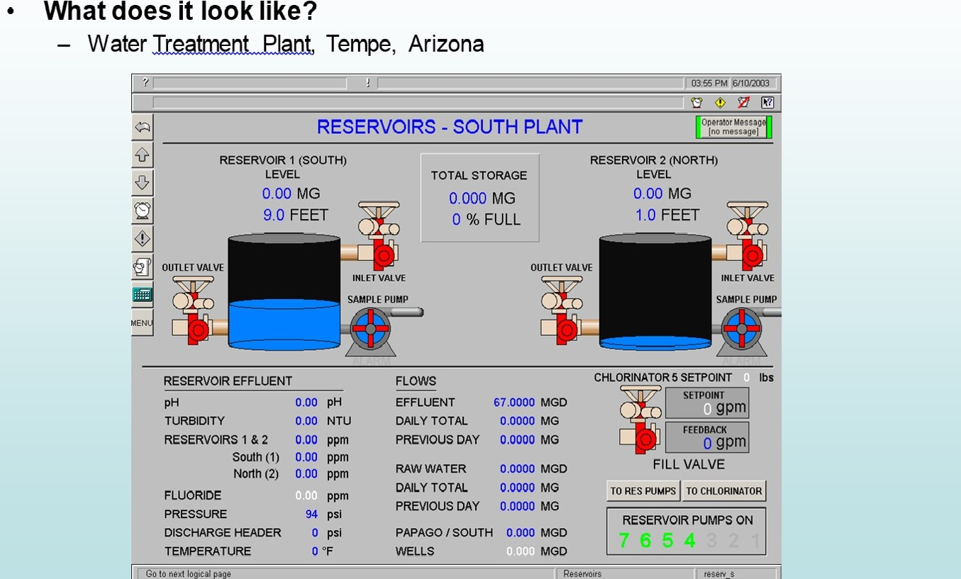
Typical Water Plant Operator Screen
Notes:
“Figure 1.3: Typical Water Plant Operator Screen (Demo)” Clark, Richard, and Stephen Miller. Framework for SCADA Cybersecurity. 2015. pp.13.

Slide 26
Packaging Line Control Screen (Demo)
Notes:
“Figure 1.4: Packaging Line Control Screen (Demo)” Clark, Richard, and Stephen Miller. Framework for SCADA Cybersecurity. 2015. pp.16.

Slide 27
What Kind of Control Can We Have?
START/STOP buttons
Setpoint entry keypads or sliders
Anything that it makes sense to have
SCADA can even do primary process control, but generally accepted engineering practices discourage this.
The process should be able to run “blind” (without a computer front-end)!

Slide 28
Historical Trend Display
Notes:
“Figure 1.6: Typical Trend Display (Demo)” Clark, Richard, and Stephen Miller. Framework for SCADA Cybersecurity. 2015. pp.17.

Slide 29
Historical Data Logging and Trending
Samples can be stored on a timed basis or ‘triggered’ meaning when a certain condition is met.
For example: sample the flow rate every time a valve opens … or just sample every 15 minutes.
Logged data can potentially be stored for thousands of separate process variables, and stored for several years (depending on the sample rate).
Historical data, dating all the way back to when the system first went online, can be called up and displayed onscreen instantaneously.

Slide 30
Alarms Display
Notes:
“Figure 1.7: Typical Alarm or Event Display (Demo)” Clark, Richard, and Stephen Miller. Framework for SCADA Cybersecurity. 2015. pp.17.

Slide 31
Alarms
Can be defined for analog and digital variables
Digital conditions can be alarmed when ON or OFF
Analog alarms can typically have separate thresholds for:
HIGH HIGH
HIGH
LOW
LOW LOW
RATE OF CHANGE
STANDARD DEVIATION
Can be displayed onscreen, as well as give an audible warning
Can be tied to a pager or text-message dialout
Can be integrated to allow acknowledgement from keypad
Alarms can also be defined by Boolean expression

Slide 32
Reports
Like trends, they can be time-based or trigger-based
End of cycle, shift, day, week, month, year, whatever
Reports can contain any information that the system has collected, going back to the beginning.
They are sometimes used as batch/job audit paperwork.
Reports can be exported and distributed using a variety of formats (.csv and .pdf files) and methods, such as email.
It is also possible to generate reports in webpage format and publish them automatically to an internet/intranet website.
Notes:
This isn’t always considered a core function of SCADA, but it is not uncommon to have this feature available.

Slide 33
Statement of Responsibility

