Slide 1
Module 10
Policy & Governance

Slide 2
Lesson Objectives
Identify information-sharing strategies and initiatives as established by the Department of Homeland Security (DHS).
Describe threat intelligence information sharing among public and private partners, including Information Sharing and Analysis Centers (ISACs).
Explain the roles that DHS’s National Cybersecurity and Communications Integration Center (NCCIC) and CISA Central play in infrastructure protection.
Describe issues relevant to specific critical infrastructure sectors, such as HIPAA and other regulations and laws.

Slide 3
Need for Information Sharing
The majority of the nation’s critical infrastructure is owned by private sector companies.
Executive Order 13636, “Improving Critical Infrastructure Cybersecurity,” issued Feb. 2013, directs the federal government to coordinate with critical infrastructure owners and operators to improve information sharing and collaboratively develop and implement risk-based approaches to cybersecurity.
Coordination among all infrastructure stakeholders is critical to protecting public safety and national security.
As part of this, the federal government can provide the private sector with access to timely and actionable information on threats and crises.
Notes:
Note to instructors: Students should review the document NIPP 2013: Partnering for Critical Infrastructure Security and Resilience. (See Required Reading section for this lesson.)

Slide 4
Policy Driven
Title II of the Homeland Security Act of 2002 (as amended) directs the Department of Homeland Security to develop a comprehensive plan for security the nation’s critical infrastructure.
DHS completed the National Infrastructure Protection Plan (NIPP) in 2006 and updated it in 2009. This plan provides a structure for creating partnerships between the Government Coordinating Councils (GCC) from the public sector and Sector Coordinating Councils (SCC) from the private sector for the 16 critical infrastructure sectors.
Aligned with the NIPP, the National Strategy for Information Sharing and Safeguarding (NSISS), issued December 2013, identifies the need to establish “information-sharing processes and sector-specific protocols with private sector partners, to improve information quality and timeliness and secure the Nation’s infrastructure.”
Notes:
Note: This document still servers as the current plan and has not been updated subsequent to 2013 at the time of this writing (2023).

Slide 5
Sector and Cross-Sector Council Structures
Sector Coordinating Councils (SCCs) – Self-organized, self-run, and self-governed private sector councils consisting of owners and operators and their representatives, which interact on a wide range of sector-specific strategies, policies, activities, and issues. SCCs serve as principal collaboration points between the government and private sector owners and operators for critical infrastructure security and resilience policy coordination and planning and a range of related sector-specific activities.
Critical Infrastructure Cross-Sector Council – Consisting of the chairs and vice chairs of the SCCs, this private sector council coordinates cross-sector issues, initiatives, and interdependencies to support critical infrastructure security and resilience.
Notes:
From the NIPP

Slide 6
Sector and Cross-Sector Council Structures (cont. 1)
Government Coordinating Councils (GCCs) – Consisting of representatives from across various levels of government (including Federal and SLTT), as appropriate to the operating landscape of each individual sector, these councils enable interagency, intergovernmental, and cross-jurisdictional coordination within and across sectors and partner with SCCs on public-private efforts.
Federal Senior Leadership Council (FSLC) – Consisting of senior officials from the SSAs and other federal departments and agencies with a role in critical infrastructure security and resilience, the FSLC facilitates communication and coordination on critical infrastructure security and resilience across the federal government.
Notes:
From the NIPP

Slide 7
Sector and Cross-Sector Council Structures (cont. 2)
State, Local, Tribal, and Territorial Government Coordinating Council (SLTTGCC) – Consisting of representatives from across SLTT government entities, the SLTTGCC promotes the engagement of SLTT partners in national critical infrastructure security and resilience efforts and provides an organizational structure to coordinate across jurisdictions on state and local government guidance, strategies, and programs.
Regional Consortium Coordinating Council (RC3) – Comprises regional groups and coalitions around the country engaged in various initiatives to advance critical infrastructure security and resilience in the public and private sectors.
Notes:
From the NIPP

Slide 8
Sector and Cross-Sector Council Structures (cont. 3)
Information Sharing Organizations – Organizations including Information Sharing and Analysis Centers (ISACs) serve operational and dissemination functions for many sectors, subsectors, and other groups, and facilitate sharing of information between government and the private sector. ISACs also collaborate on a cross-sector basis through a national council.
Notes:
From the NIPP

Slide 9
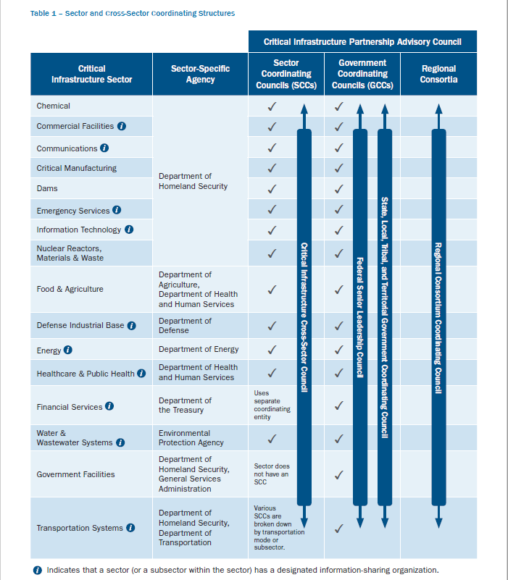
Coordinating Structures
Sector and Cross-Sector Coordinating Structures: Partnership Structure of the 16 Sectors and Designated Agency Lead Coordinators
Image source: https://www.dhs.gov/sites/default/files/publications/
National-Infrastructure-Protection-Plan-2013-508.pdf. Page 11.
Notes:
From the NIPP. This illustrates the partnership structure of the 16 sectors and designated agency lead coordinators.
Image Attribution:
Dept. of Homeland Security. United States. “Table 1 – Sector and Cross-Sector Coordinating Structures”. NIPP 2013: Partnering for Critical Infrastructure Security and Resilience. pp. 11. <https://www.dhs.gov/sites/default/files/publications/National-Infrastructure-Protection-Plan-2013-508.pdf>.

Slide 10
NIPP Partnership Approach
The NIPP recognizes that risk management must be a collaborative effort in its seven core tenets:
  Risk should be identified and managed in a coordinated and comprehensive way across the CI community to enable the effective allocation of security and resilience resources.
  Understanding and addressing risks from cross-sector dependencies and interdependencies is essential to enhancing CI security and resilience.
  Gaining knowledge of infrastructure risk and interdependencies requires information sharing across the CI community.
Notes:
The complete text of the seven core tenets of the NIPP is as follows:
1. Risk should be identified and managed in a coordinated and comprehensive way across the critical infrastructure community to enable the effective allocation of security and resilience resources.
Collaboratively managing risk requires sharing information (including smart practices), promoting more efficient and effective use of resources, and minimizing duplication of effort. It enables the development and execution of more comprehensive measures to secure against, disrupt, and prepare for threats; mitigate vulnerabilities; and reduce consequences across the Nation. To ensure a comprehensive approach to risk management, the critical infrastructure community considers strategies to achieve risk mitigation, as well as other ways to address risk, including acceptance, avoidance, or transference.
2. Understanding and addressing risks from cross-sector dependencies and interdependencies is essential to enhancing critical infrastructure security and resilience.
The way infrastructure sectors interact, including through reliance on shared information and communications technologies (e.g., cloud services), shapes how the Nation’s critical infrastructure partners should collectively manage risk. For example, all critical infrastructure sectors rely on functions provided by energy, communications, transportation, and water systems, among others. In addition, interdependencies flow both ways, as with the dependence of energy and communications systems on each other and on other functions. It is important for the critical infrastructure community to understand and appropriately account for dependencies and interdependencies when managing risk.
3. Gaining knowledge of infrastructure risk and interdependencies requires information sharing across the critical infrastructure community.
Through their operations and perspectives, stakeholders across the critical infrastructure community possess and produce diverse information useful to the enhancement of critical infrastructure security and resilience. Sharing and jointly planning based on this information is imperative to comprehensively address critical infrastructure security and resilience in an environment of increasing interconnectedness. For that to happen, appropriate legal protections, trusted relationships, enabling technologies, and consistent processes must be in place.

Slide 11
NIPP Partnership Approach (cont. 1)
  The partnership approach to CI security and resilience recognizes the unique perspectives and comparative advantages of the diverse CI community.
  Regional and SLTT partnerships are crucial to developing shared perspectives on gaps and actions to improve CI security and resilience.
  Infrastructure critical to the United States transcends national boundaries, requiring cross-border collaboration, mutual assistance, and other cooperative agreements.
  Security and resilience should be considered during the design of assets, systems, and networks.
Notes:
The complete text of the seven core tenets of the NIPP is as follows (continued):
4. The partnership approach to critical infrastructure security and resilience recognizes the unique perspectives and comparative advantages of the diverse critical infrastructure community.
The public-private partnership is central to maintaining critical infrastructure security and resilience. A well-functioning partnership depends on a set of attributes, including trust; a defined purpose for its activities; clearly articulated goals; measurable progress and outcomes to guide shared activities; leadership involvement; clear and frequent communication; and flexibility and adaptability. All levels of government and the private and nonprofit sectors bring unique expertise, capabilities, and core competencies to the national effort. Recognizing the value of different perspectives helps the partnership more distinctly understand challenges and solutions related to critical infrastructure security and resilience.
5. Regional and SLTT partnerships are crucial to developing shared perspectives on gaps and actions to improve critical infrastructure security and resilience.
The National Plan emphasizes partnering across institutions and geographic boundaries to achieve security and resilience. Risks often have local consequences, making it essential to execute initiatives on a regional scale in a way that complements and operationalizes the national effort. This requires locally based public, private, and nonprofit organizations to provide their perspectives in the assessment of risk and mitigation strategies. Local partnerships throughout the country augment the efforts of existing partnerships at the national level and are essential to a true national effort to strengthen security and resilience.
6. Infrastructure critical to the United States transcends national boundaries, requiring cross-border collaboration, mutual assistance, and other cooperative agreements.
The United States benefits from and depends upon a global network of infrastructure that enables the Nation’s security and way of life. The distributed nature and interconnectedness of these assets, systems, and networks create a complex environment in which the risks the Nation faces are not distinctly contained within its borders. This is increasingly the case as services provided by critical infrastructure are often dependent on information gathered, stored, or processed in highly distributed locations. It is imperative that the government, private sector, and international partners work together. This includes collaborating to fully understand supply chain vulnerabilities and implement coordinated, and not competing, global security and resilience measures. The National Plan is focused on domestic efforts in critical infrastructure security and resilience, while recognizing the international aspects of the national approach.
7. Security and resilience should be considered during the design of assets, systems, and networks.
As critical infrastructure is built and refreshed, those involved in making design decisions, including those related to control systems, should consider the most effective and efficient ways to identify, deter, detect, disrupt, and prepare for threats and hazards; mitigate vulnerabilities; and minimize consequences. This includes considering infrastructure resilience principles.

Slide 12
Infrastructure Resilience Planning Framework (IRPF)
In 2021, CISA released the IRPF to assist state, local, tribal, and territorial planners protect infrastructure (SLTT), this was updated in 2022.
The IRPF helps SLTT partners include critical infrastructure resilience into their planning activities. It provides additional resources and guidance, such as:
  Information on finding geospatial information systems (GIS) on CI assets.
  Guidance on how to diversify planning opinions and engage stakeholders.
  Guidance on drought hazards and their impact on infrastructure systems, and resources for assessing and mitigating drought risk.
  Incorporates CISA methodology for Assessing Regional Infrastructure Resilience.
Notes:
Available at: Cybersecurity and Infrastructure Security Agency (CISA). “Infrastructure Resilience Planning Framework (IRPF), Version 1.1.” November 2022. Available at: https://www.cisa.gov/sites/default/files/publications/Infrastructure-Resilience%20Planning-Framework-%28IRPF%29%29.pdf .

Slide 13
Role of Information Sharing and Analysis Centers (ISACs) in CIP
Information Sharing and Analysis Organizations (ISACs) facilitate the dissemination and sharing of threat intelligence information between government and private sector. The primary activities of an ISAC include:
  Providing trusted communities and frameworks to facilitate the sharing of timely, actionable, and reliable information for situational awareness;
  Providing in-depth comprehensive sector threat and incident analysis and enabling aggregation and anonymization of data;
  Providing all-hazards threat warning and incident reporting to enhance member risk mitigation activities;
  Developing and maintaining, as applicable, collaborative relationships with operations centers such as the CISA Central and NCCIC; and
  Participating in the planning, coordination, and conduct of exercises, as applicable.
Notes:
From the NIPP. The National Council of ISACs is located at https://www.nationalisacs.org/

Slide 14
Homeland Security Information Network (HSIN)
Trusted network for sharing Sensitive but Unclassified (SBU) information among government and private sector owners and operators and other federal, state, and local government agencies protecting critical infrastructure.
They provide real-time virtual meeting space and alerts, and instant messaging capabilities to enable partners to receive timely and accurate information on threats, vulnerabilities, security, and response to critical infrastructure.
Notes:
Source: https://www.dhs.gov/hsin-critical-infrastructure

Slide 15
CISA Central Reporting
A dedicated 24/7/365 coordination and information-sharing operations center that maintains situational awareness of the nation’s CI, serving as a hub between the government and the 16 critical infrastructure.
Products provided to its FSLTT government and industry partners include:
  Daily Operations Report (DOR)
  Awareness Message (AM)
  Situation Report (SITREP)
  Ransomware Reporting Summary
Notes:
Daily Operations Report: Daily report that provides updates on ongoing CISA operations.
Awareness Message: Event-driven report that signals to partners that CISA is interested in the event.
Situation Report: Event-driven report that details ongoing physical communications, or cyber event/incident (hurricane, etc.).
Ransomware Reporting Summary: Daily report that lists ransomware attacks with which CISA has an interest.

Slide 16
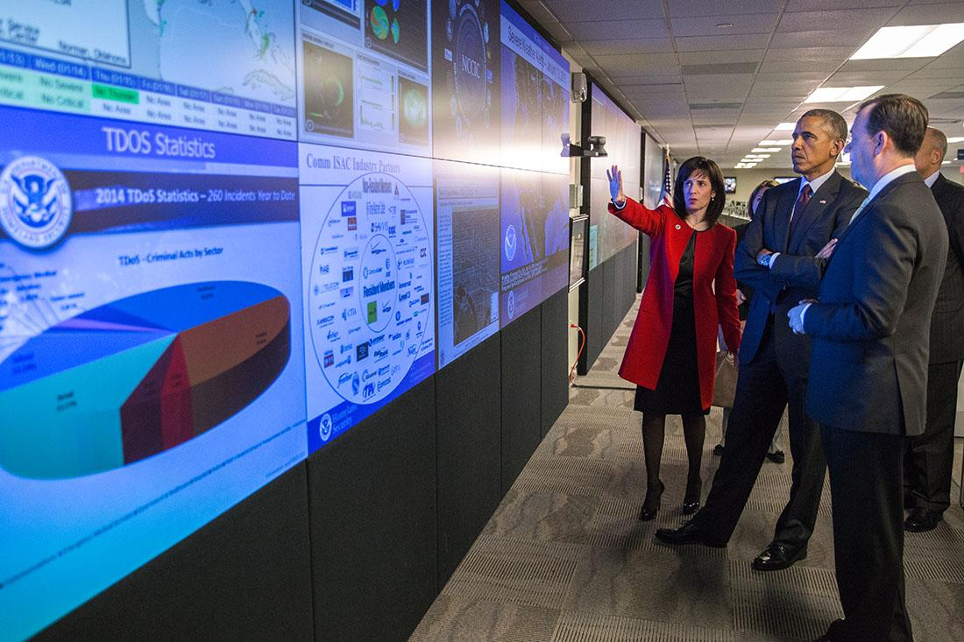
National Cybersecurity and Communications Integration Center (NCCIC)
Established by PPD-21, the National Cybersecurity and Communications Integration Center (NCCIC) serves as a 24/7 information sharing, analysis, and incident response center “where government, private sector, and international partners share information and collaborate on response and mitigation activities to reduce the impact of significant incidents, enhance partners’ security posture, and develop and issue alerts and warnings while creating strategic and tactical plans to combat future malicious activity. “
DHS NCCIC Operations Center
Notes:
Image Source: “President Barack Obama tours the National Cybersecurity and Communications Integration Center in Arlington, Virginia.” by Pete Souza. January 13, 2015. Public Domain.
Retrieved https://www.whitehouse.gov/blog/2015/01/14/securing-our-cyberspace-president-obamas-new-steps-strengthen-americas-cybersecurity

Slide 17
Specific Critical Infrastructure Issues
Because of the diverse nature of critical infrastructure, numerous specific regulations govern these industries, among them:
  Health Insurance Portability and Accountability Act of 1996 (HIPAA) that provides data privacy and security for medical information held by healthcare providers and affiliates.
  Gramm-Leach-Bliley Act (GLBA), aka Financial Services Modernization Act of 1999 that establishes privacy and security safeguards on financial products and services. Applies to financial organizations, such as banks, brokers, and lenders.
  Sarbanes-Oxley Act of 2002 protects shareholders and the public from fraudulent accounting practices by governing financial disclosures of all publicly-traded companies.
  Payment Card Industry Data Security Standard (PCI-DSS). Not a law, but a standard established by credit card companies (Visa, MasterCard, American Express, etc.) governing privacy and security of customer personally identifiable information and account information.

